Slide 1
Detecting near-duplicates for web crawling
Authors: Gurmeet Singh Manku, Arvind Jain, Anish Das Sarma
Presented by YuLong Pei
Notes:
Manku, Gurmeet Singh, Arvind Jain, and Anish Das Sarma. "Detecting near-duplicates for web crawling." Proceedings of the 16th international conference on World Wide Web. ACM, 2007.

Slide 2
Intro/Background
Many near duplicate web documents
Exact duplicates: mirroring, plagiarism
Easy to find with checksum
Near duplicates: identical content but differ in small portions like ads, counters, timestamps
Elimination saves network bandwidth, reduces storage cost, improves quality of search indexes, reduces load on remote hosts

Slide 3
Related Works
Various techniques developed to deal with different:
Corpus: web documents, files in a file system, e-mails, domain-specific corpora
End goals: web mirrors, clustering for “related documents” query, data extraction, plagiarism, spam detection, duplicated in domain-specific corpora
Feature-set per document: shingles from page content, document vector from page content, connectivity information, anchor text, anchor window, phrases
Signature schemes: mod-p shingles, min-hash for Jaccard similarity of sets, signatures/fingerprints over IR-based document vectors, checksums
This paper focus on large sized web document, improve web-crawling, using document vector, and simhash for small-sized fingerprints.

Slide 4
Why we care
Knowing about existing techniques is good start to finding our own algorithm
Find near duplicates between files and cluster the files
Extract data and information from the files
Google’s example is good because it experimented with large amounts of files, so Big Data
8Billion files vs ten of thousands

Slide 5
Problem to solve
Hamming Distance Problem: In collection of f-bit fingerprints, quickly find all fingerprints that differ from given query fingerprint in at most k bit positions, where k is small integer
technique needs to be useful for both online queries (single fingerprints) and batch queries (multiple fingerprints)
Fingerprints: Charikar’s simhash
convert web-page into set of features, each feature has weight

Slide 6
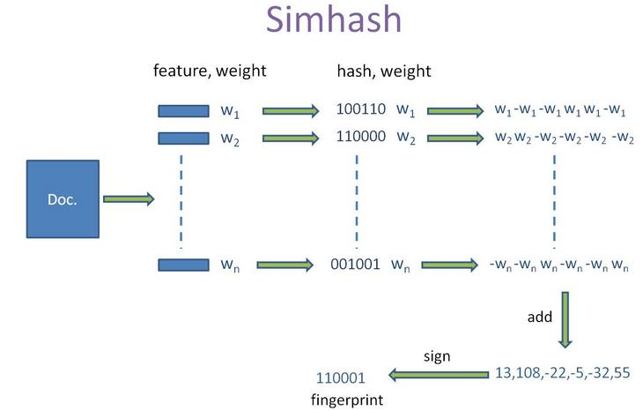
Charikar’s simhash
Notes:
- given set of features and their weights
- maintain an f-dimensional vector V, each of whose dimension is initialized to zero
- a feature is hashed into f-bit hash value
- f bits (unique to the feature) increment/decrement f components of vector by the weight of feature
- if i-th bit of hash value is 1, i-th component of V is incremented by weight of feature
- if i-th bit of hash value is 0, i-th component of V is decremented by weight of feature
- when all feature is processed, signs of components determine corresponding bits of final fingerprint

Slide 7
Properties of simhash
A. fingerprint of document is a "hash" of its features
B. similar documents have similar hash values (uncommon with hash functions)
Assumption: Property A holds, experimentally measure impact of B
→ fingerprints are distributed uniformly at random, with some non-uniformity

Slide 8
Hamming Distance: Single Query
Table 1
π1(F1)
π1(F2)
Table i
πi(F1)
πi(F2)
Table t
πt(F1)
πt(F2)
...
...
- Permuted f-bit sorted
- table compressed and sorted
Runtime:
- O(pi) steps by binary search
- O(log pi) interpolation search shrinks
Probe
Given:
Fingerprint F
Integer k
1. identify all permuted fingerprints in Ti whose top pi bit-positions match top pi bit-positions of πi(F)
2. for each found, check if it differs from πi(F) in at most k bit-position
Notes:
- build t tables: T1, T2, ..., Tt
- associated Ti are 2 quantities: integer pi and permutation πi over f bit-positions
- Table Ti constructed by applying permutation πi to each existing fingerprint, resulting set of permuted f-bit fingerprint are sorted
- each table compressed and sorted in main-memory
- given fingerprint F and integer k, probe tables in parallel:
1. identify all permuted fingerprints in Ti whose top pi bit-positions match top pi bit-positions of πi(F)
2. for each of permuted fingerprints identified in 1. check if it differs from πi(F) in at most k bit-position
- 1. O(pi) steps by binary search; if assume each fingerprint truly random bit sequence, interpolation search shrinks run time to O(logpi) steps in expectation.

Slide 9
Hamming Distance: Batch Queries
- 8B existing fingerprints (F) and batch of 1M query fingerprints (Q) are stored in files
- in Google, GFS breaks the files into smaller files
- MapReduce
Mapper: solves Hamming Distance Problem over each chunk of F and entire file Q
Reducer: collects output of list of near-duplicate fingerprints found, removes duplicates and produce single sorted file
Different from single queries
- build tables corresponding to file Q (for single F table is built for existing fingerprint file)

Slide 10
Compression of fingerprints
- successive fingerprints share top d bits in expectation
- have h denote position of most significant 1-bit of XOR of two successive fingerprints
- find distribution of h values and find Huffman code
- first fingerprint in block remembered entirely; subsequent once are XOR with previous fingerprint and appended with Huffman code and rest of bits; until block is full
Scalability: 200 mappers, 64 GB → 32GB compressed, < 100 seconds

Slide 11
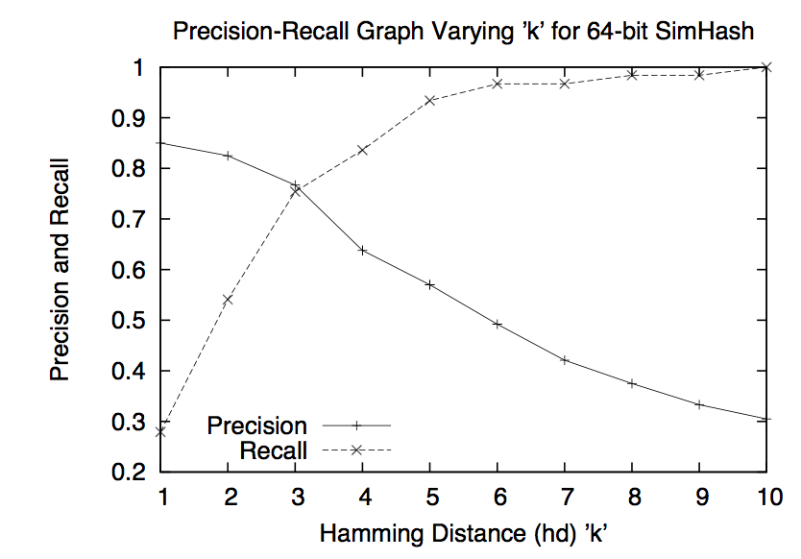
Experimental Results
Parameter Choice:
K = 3, f = 64

Slide 12
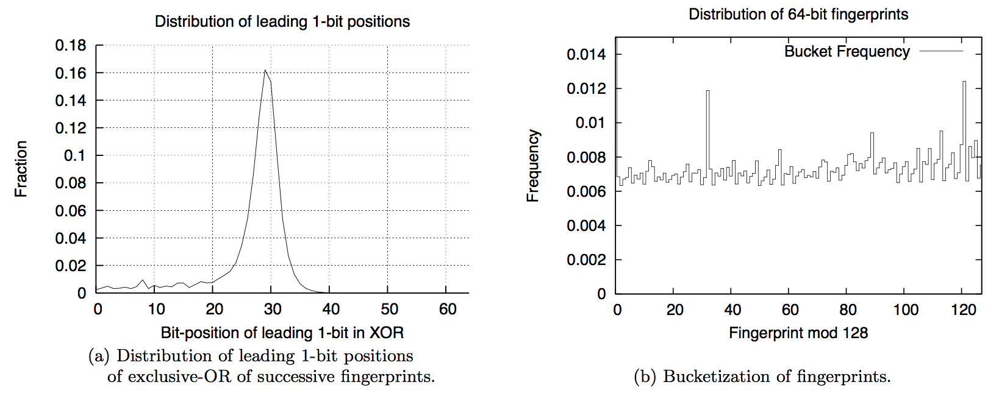
Experimental Results
- true randomness, entire graph should exhibit right side
- Dense on left side due to clustering
- spikes from empty page, page not found, same bulletin board software

Slide 13
Future works
Categorize web-pages into different categories, search only from within
Does simhash-based technique work for focused crawlers
Can near duplicate detection develop to facilitate clustering

Slide 14
Conclusion
Algorithm for near-duplicate detection using simhash
Simhash create small-sized fingerprint, great for the scale of the problem
Need to work with online mode and batch mode
Experiment to find good results with f = 64, k = 3

Slide 15
Pro/Con of the Paper
Pro:
Nice structure
Many examples for readers to understand why detect near-duplicate
Con:
Inconsistency that led to error in description
Poor explanation for some technical concepts

Slide 16
References
Manku, Gurmeet Singh, Arvind Jain, and Anish Das Sarma. "Detecting near-duplicates for web crawling." Proceedings of the 16th international conference on World Wide Web. ACM, 2007.
Massive Algorithms, SimHash: Hash-based Similarity Detection; http://massivealgorithms.blogspot.com/2014/12/simhash-hash-based-similarity-detection.html

